Slide 1

Network Layer - IP Routing Protocols
CE3005: Computer Networks
CZ3006: Netcentric Computing
Prof.Mo Li
e-mail: limo@ntu.edu.sg
Location: N4-2b-61
School of Computer Science and Engineering

Slide 2
Contents
Internet Routing
  Concept of Autonomous System (AS)
  Intra-AS and Inter-AS Routing
Intra-AS Routing
  Distance Vector Routing
    e.g. Routing Information Protocol (RIP)
  Link State Routing
    e.g. Open Shortest Path First (OSPF)
Inter-AS Routing
  Path Vector Routing
    e.g. Border Gateway Protocol (BGP)

Slide 3
Transport layer
Routing protocols
RIP, OSPF, BGP
IP protocol
addressing
fragmentation
Network
layer
routing
table
ARP protocol
Link layer
Physical layer

Slide 4
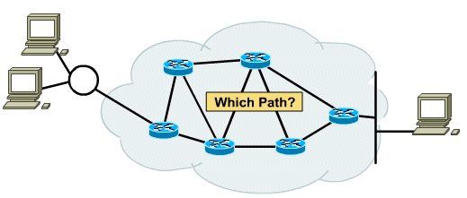
Router
A router is a device used to interconnect networks, and to forward packets by examining the destination address in the IP header of each packet.
How does a router decide which path to forward?
>> Routing Protocol, used to initialize/update routing table so that a route/path can be determined.

Slide 5
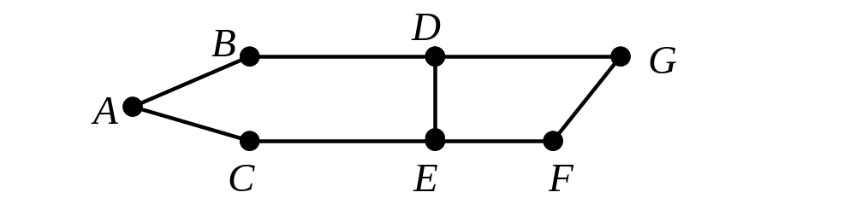
Routing: Flooding
A straight forward way of routing is by flooding.
When a node receives a packet, it will forward the packet to all other links except the incoming link. The packet will be labeled with a unique identifier
Should the same packet return, the packet will be discarded
Packets transmitted using flooding is 9

Slide 6
Routing: Flooding
Advantages:
  A packet will always get through if one or more path exists (very robust)
Disadvantages:
  Very wasteful of bandwidth, may cause serious congestion, hence not used in the Internet
Applications:
  Military applications (routers may be destroyed anytime)
  Ad hoc wireless networks (nodes may be turned off or moved away anytime)

Slide 7
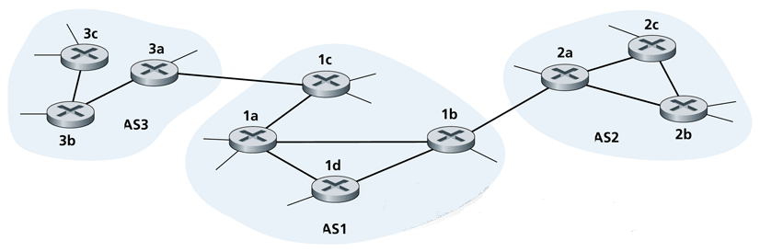
Routing in the Internet
For routing purpose, Internet is divided into Autonomous Systems (AS). An AS is a group of routers under the authority of a single administration; e.g. an ISP.
Each AS is uniquely identified by a 2-byte (0 - 65,535) or 4-byte (65,536 - 4,294,967,295) ASN (AS number), which is assigned by IANA; e.g. ASN of NTU: AS9419.

Slide 8
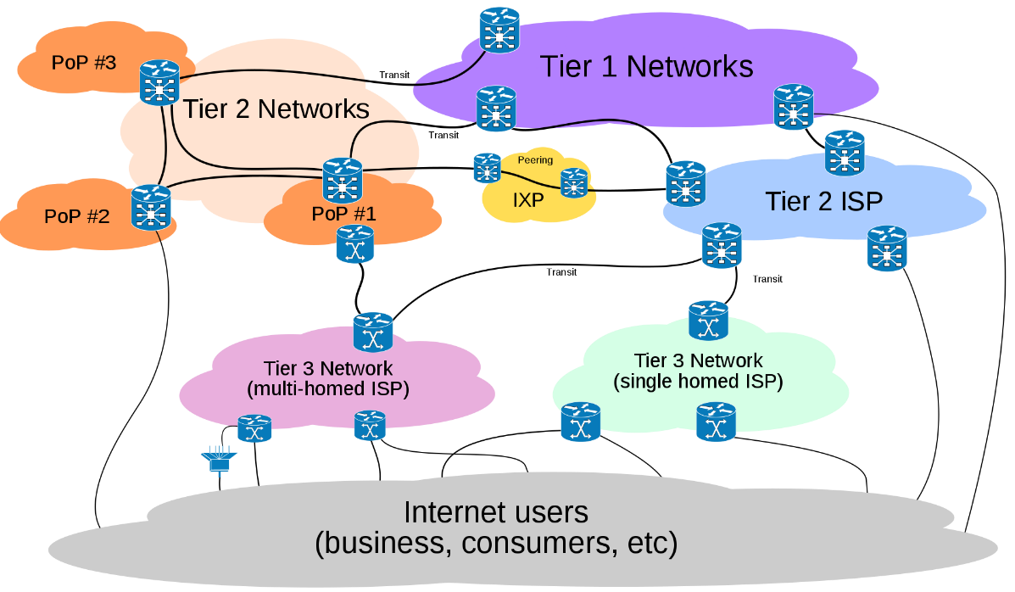
Routing in the Internet
For routing purpose, Internet is divided into Autonomous Systems (AS). An AS is a group of routers under the authority of a single administration; e.g. an ISP.
Each AS is uniquely identified by a 2-byte (0 - 65,535) or 4-byte (65,536 - 4,294,967,295) ASN (AS number), which is assigned by IANA; e.g. ASN of NTU: AS9419.

Slide 9
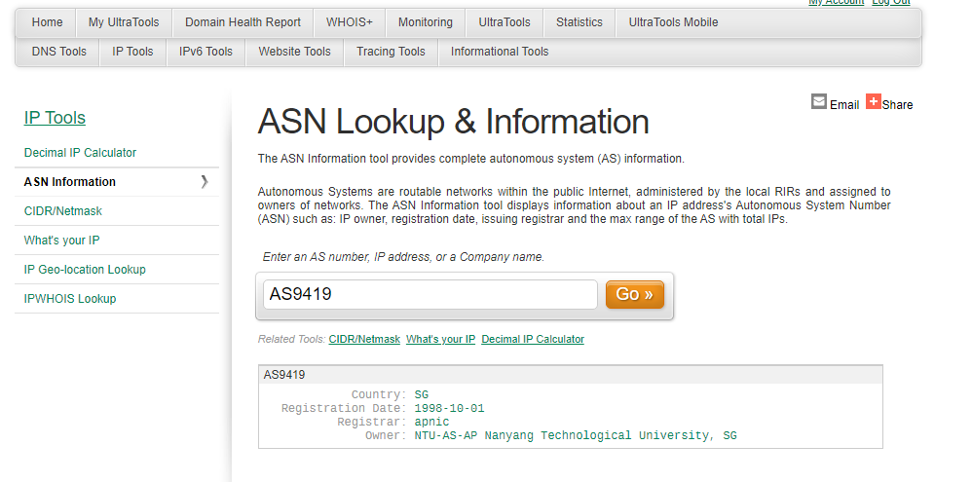
www.ultratools.com

Slide 10
Intra-AS and Inter-AS Routing
In practice, routing in Internet is done in a hierarchical manner, which includes intra-AS and inter-AS routings.
Inter-AS routing protocol
(BGP)
Intra-AS routing protocol
(RIP/OSPF)

Slide 11
Intra-AS and Inter-AS Routing
In practice, routing in Internet is done in a hierarchical manner, which includes intra-AS and inter-AS routings.
Intra-AS Routing:
Routing within an AS
Protocols for Intra-AS routing are also called Interior Gateway Protocols (IGPs)
Different AS can choose to run their preferred protocols
e.g. intra-AS routers: 1a, 1b, 1c, 1d in AS1
Inter-AS Routing:
Routing between AS
Protocols for Inter-AS routing are also called Exterior Gateway Protocols (EGPs)
All AS must run the same standard protocol
e.g. inter-AS routers: 1b, 2a, 1c, 3a

Slide 12
Why different Intra- and Inter-AS Routing?
Policy:
  Inter-AS: different admin wants control over how its traffic are forwarded, who routes through its network
  Intra-AS: single admin, so no policy decision needed
Performance:
  Intra-AS: can focus on performance
  Inter-AS: policy may dominate over performance
Scale:
  Internet is too large to be treated as a single routing domain

Slide 13
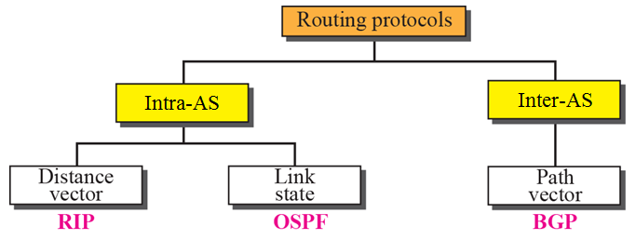
Intra-AS and Inter-AS Routing Protocols
Routing protocols
RIP, OSPF, BGP
routing
table

Slide 14
Intra-AS Routing:
Distance Vector Routing
Distance Vector routing also known as “Bellman-Ford” or “old ARPANET” routing.
Essentially, consists of 3 main stages:
❶ Discover neighbors by multicasting request
Exchange distance vectors (routing information) with immediate neighbors only
  Response to request
  Periodic updates (typically 30s interval)
  Triggered updates due to changes
❸ Compute shortest-path routes (using Bellman-Ford algorithm)

Slide 15
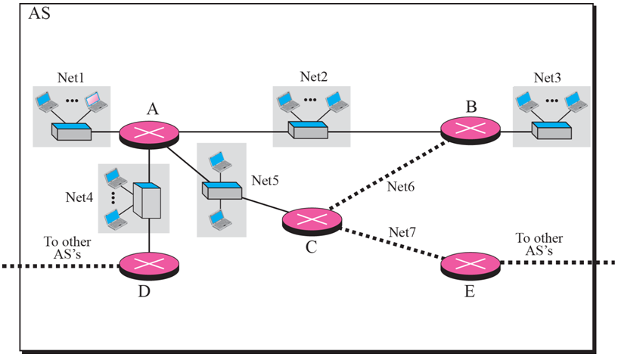
An example of Distance Vector Routing
Net: Network can be a LAN, or a point-to-point link

Slide 16
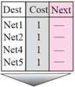
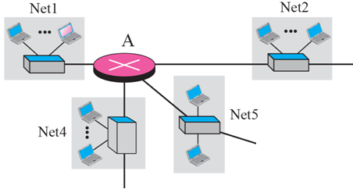
Distance Vector Routing: Initially, a router only has its own configured routing table.
For simplicity but without loss of generality, assume each link has a cost of 1.

Slide 17

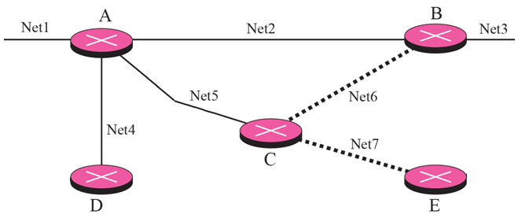


Distance Vector Routing: Discover Adjacent Neighbors and exchange distance vectors.
request
request
response
request
response
response

Slide 18
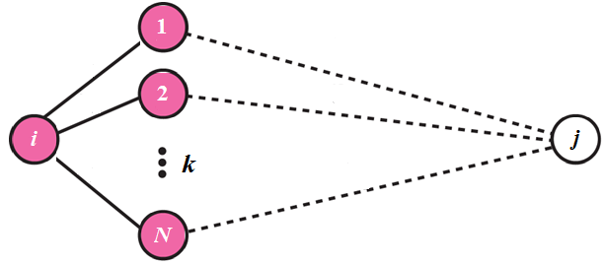


Distance Vector Routing: Computing Shortest-Path using Bellman-Ford Algorithm
D_{1j}
d_{i1}
Net
d_{i2}
D_{2j}
d_{iN}
// D_{ij} = ∞ if not reachable initially
for neighbor k = 1 to N {
if ( d_{ik} + D_{kj} < D_{ij} ) {
  D_{ij} = d_{ik} + D_{kj} ;
}}
D_{Nj}
cost of going directly from node i to adjacent neighbor node k ;
least total cost of going from node i to destination j

Slide 19
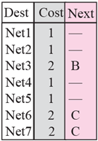

Distance Vector Routing: Computing Shortest-Path using Bellman-Ford Algorithm
from B:
from C:
original routing table of A
from D:
updated routing table of A
Assume Cost of 1 between node

Slide 20
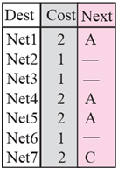
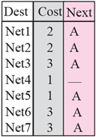
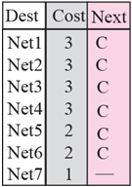
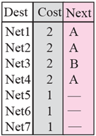
Distance Vector Routing: Resulting routing tables at each router after convergence.

Slide 21
Quote about Distance vector
Not as fast as
Link state
GOOD news travel fast,
BAD news travel slowly
Caused by
count to Infinity

Slide 22
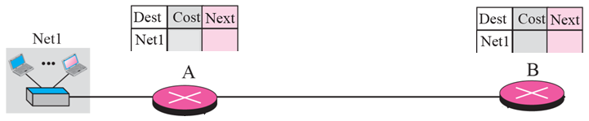
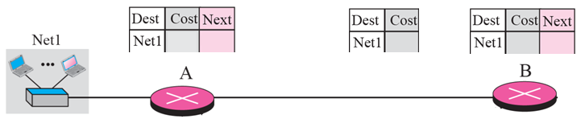
Distance Vector Routing: Count-to-Infinity problem
Before failure:
1
-
2
A
After failure:
Periodic update from B
∞
-
2
2
A

Slide 23
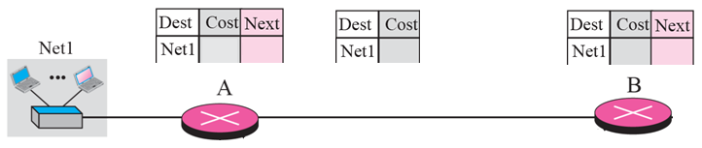
Distance Vector Routing: Count-to-Infinity problem
After A received update from B:
Triggered update from A
3
B
3
2
A
After B received update from A:
Triggered update from B
3
B
4
4
A

Slide 24
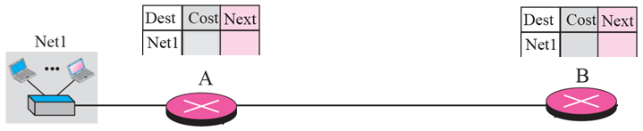
Distance Vector Routing: Count-to-Infinity problem
Eventually:
∞
B
∞
A

Slide 25
Distance Vector Routing: Solving Count-to-Infinity Problem - Split Horizon with Poisoned Reverse (RFC 2453)
If B gets to Net1 via A, then its update to A should indicate that Net1 is unreachable.
Periodic update from B
1
-
∞
2
A

Slide 26
Intra-AS Distance Vector Routing:
Routing Information Protocol
RIP uses Distance Vector algorithm, cost is simply based on the number of hops
Allows maximum 15 hops, 16 indicates ∞
Routing information exchanged every 30 sec via Response Message
If no advertisement heard after 180 seconds → neighbor/link declared dead
RIP related RFC Documentations:
  RFC 1058, 1387, 1388, 1723 (RIP version 2)

Slide 27
Intra-AS and Inter-AS Routing Protocols

Slide 28
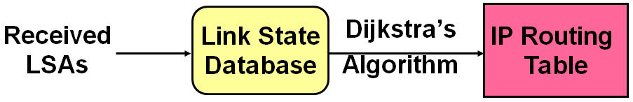
Intra-AS Routing:
Link State Routing
Consists of Five stages:
❶ Discover Neighbors by multicasting Hello
❷ Construct Link State Advertisement Packet (LSA/LSP)
Flood LSA/LSP to ALL Routers
  During initial start-up
  When there is a change in topology
❹ Construct Link State Database
❺ Compute Shortest-Path Routes (using Dijkstra’s algorithm)

Slide 29
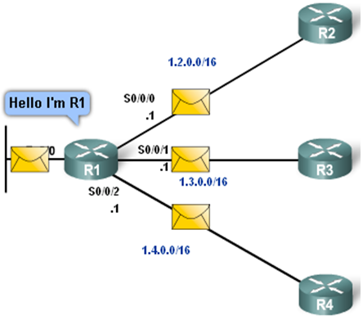
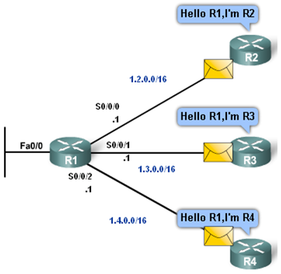
Link State Routing: Discover Neighbors
10.2.0.0/16
10.3.0.0/16
10.2.0.0/16
10.4.0.0/16
10.3.0.0/16
10.4.0.0/16
A transmits HELLO packet on each of its links
A ’s neighbors identify themselves to A

Slide 30
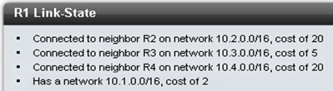
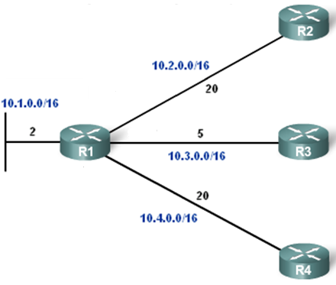
Link State Routing: Construct Link State Advertisement Packet (LSA/LSP)
LSA/LSP contains information of itself and immediate neighbors only.

Slide 31
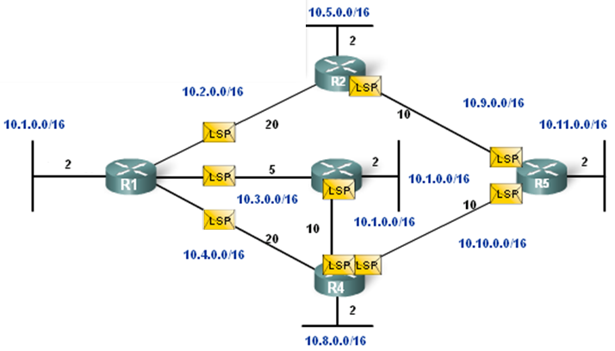
Link State Routing: Flood LSP to ALL routers

Slide 32
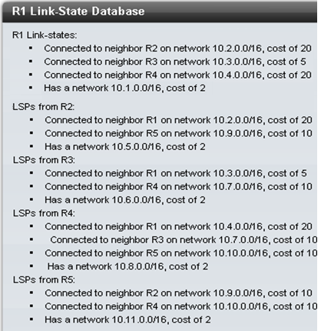
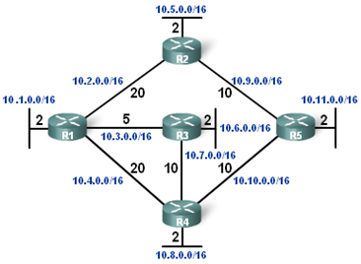
Link State Routing: Build Link State Database
Each router builds its own link state database to have a complete topology of the whole network.

Slide 33
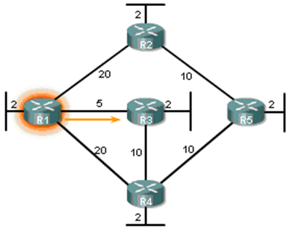

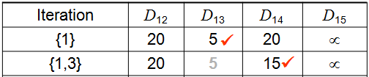
Link State Routing: Compute shortest-path routes using Dijkstra’s Algorithm

Slide 34
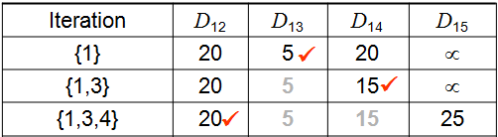
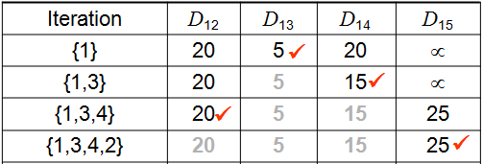
Link State Routing: Compute shortest-path routes using Dijkstra’s Algorithm

Slide 35
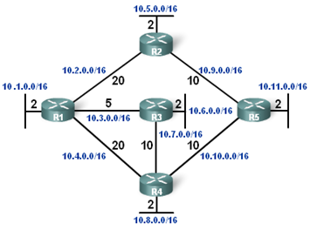
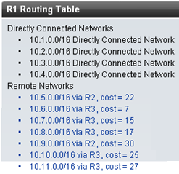
Link State Routing: Update routing table

Slide 36
Intra-AS Link State Routing:
Open Shortest Path First
“Open”: publicly available
Uses Link State algorithm
  LSA packet dissemination
  Topology map at each node
  Route computation using Dijkstra’s algorithm
Advertisements disseminated to entire AS (via flooding)
OSPF related RFC documentations:
  RFC 1131, 1247, 1583 (OSPF version 2)

Slide 37
Intra-AS and Inter-AS Routing Protocols

Slide 38

Inter-AS Path Vector Routing:
Border Gateway Protocol (BGP)
Consists of 3 main stages:
❶ Configure border router to know its neighbors
Exchange path vectors (routing information) with neighbors
❸ Select path based on policy
BGP: the de facto standard, current ver 4 (RFC 4271)
port: 179
  After configuration, BGP routers establish TCP connections with their neighbors to exchange routing information.

Slide 39
Protocol design principles
Scalable. Backbone AS must be able to find the destination.
Loop free.
Autonomy of AS routing policy

Slide 40

Broadly, AS can be classified into stub AS, multi-homed AS or transit AS.
backbone provider
Transit AS – connected to other AS to carry transit traffic for its customers; mainly the providers, i.e. ISPs
peering
customer/provider
customer/provider
peering
customer/provider
customer
Stub AS – connected to only one other AS; typically customer connected to its provider. In fact, it’s not necessary for stub AS to run BGP since it has only 1 path to its ISP.
customer
Multi-homed AS – connected to more than one AS, but does not carry transit traffic; typically for customer requiring reliability

Slide 41

Broadly, AS can be classified into stub AS, multi-homed AS or transit AS.
Transit AS – connected to other AS to carry transit traffic for its customers; mainly the providers, i.e. ISPs
Stub AS – connected to only one other AS; typically customer connected to its provider. In fact, it’s not necessary for stub AS to run BGP since it has only 1 path to its ISP.
Multi-homed AS – connected to more than one AS, but does not carry transit traffic; typically for customer requiring reliability

Slide 42


Configuring BGP routers to know their neighbors (peers) to establish TCP connections.
BGP TCP Connection
AS 200
AS 300
150.10.0.0/16
140.10.0.0/16
192.10.1.0/30
A
B
.1
.2
C
D
interface Serial 0
ip address 192.10.1.1 255.255.255.252
router bgp 200
network 150.10.0.0 mask 255.255.0.0
neighbor 192.10.1.2 remote-as 300
interface Serial 0
ip address 192.10.1.2 255.255.255.252
router bgp 300
network 140.10.0.0 mask 255.255.0.0
neighbor 192.10.1.1 remote-as 200
External peers (between different AS) are normally adjacent to each other and share a subnet.
Internal peers may be in any subnet within the same AS.

Slide 43


Peers exchange routing information containing complete AS Path (to avoid loop problem)
Network Next-Hop Path
150.10.0.0/16 192.10.1.1 200
160.10.0.0/16 192.10.1.1 200 100
AS 200
AS 300
192.10.1.0/30
140.10.0.0/16
150.10.0.0/16
C
.1
.2
D
E
Network Next-Hop Path
150.10.0.0/16 192.10.1.1 200
160.10.0.0/16 192.10.1.1 200 100
B
.2
192.20.2.0/30
.1
Network Next-Hop Path
160.10.0.0/16 192.20.2.1 100
Next-hop not changed between internal peers.
A
AS 100
160.10.0.0/16

Slide 44
AS Table content
Network Next-Hop Path
150.10.0.0/16
160.10.0.0/16 192.20.2.1 100
140.10.0.0/16 192.10.1.2 300
AS 200
AS 300
192.10.1.0/30
140.10.0.0/16
150.10.0.0/16
C
.1
.2
D
E
Network Next-Hop Path
140.10.0.0/16
150.10.0.0/16 192.10.1.1 200
160.10.0.0/16 192.10.1.1 200 100
B
.2
192.20.2.0/30
.1
A
AS 100
160.10.0.0/16

Slide 45
There is also the commercial relationship between neighbouring ASes.
ASes relationship:
Customer-Provider: Customer pays the provider to send and receive traffic
  e.g. NTU and SingTel
Peer-to-peer: Two Ases agree to transit each other traffic.
  eg. SingAREN and AARnet
p2p
c2p

Slide 46
Based on policy, BGP routers can decide to accept/decline offered paths; and to drop/ advertise paths to their neighbors.
Path selection (policy-based):
Import policy: may or may not select path offered
  e.g. cost, business relationships, don’t route through competitors, loop prevention reasons.
Export policy: can filter routes you don’t want to tell neighbors
  eg. don’t want to route traffic to Z → don’t advertise any route to Z

Slide 47
ISP interconnection fees will not be regulated, says IDA
Fees smaller ISPs pay StarHub and Singtel not hurting consumers, says watchdog
Irene Tham
Tech Editor
itham@sph.com.sg
The local authorities will not interfere with interconnection fees that smaller Internet service providers (ISPs) pay to the two major telcos here, saying that consumers have not been harmed.
The Infocomm Development Authority (IDA) issued its decision earlier this week after concluding its two-month public consultation held last year.
Smaller ISPs like M1, ViewQwest, MyRepublic and SuperInternet pay Singtel and StarHub fees for the shortest path - and fastest access - for their subscribers and hosted websites. Some of them said it was two to three times the price of international links charged by international telcos.
Date: 27 August 2016
Source: The Straits Times

Slide 48
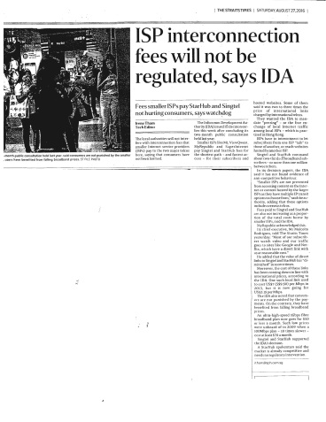
backbone provider
Singtel
backbone provider
Starhub
peering
peering
customer/provider
customer/provider
customer
customer
customer

Slide 49
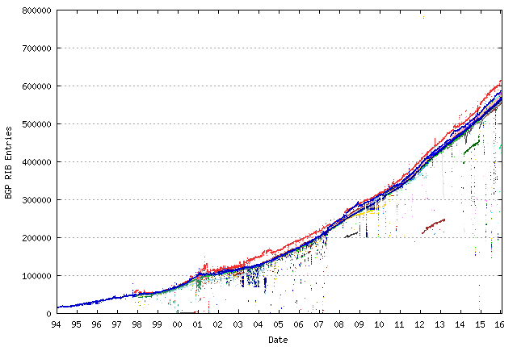
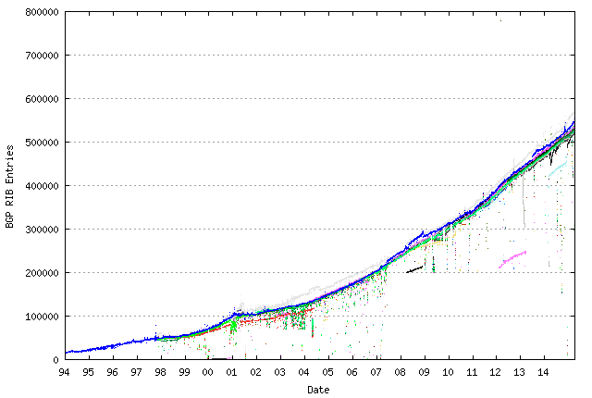
BGP routing table from 1994 - present
Source : http://bgp.potaroo.net/

Slide 50
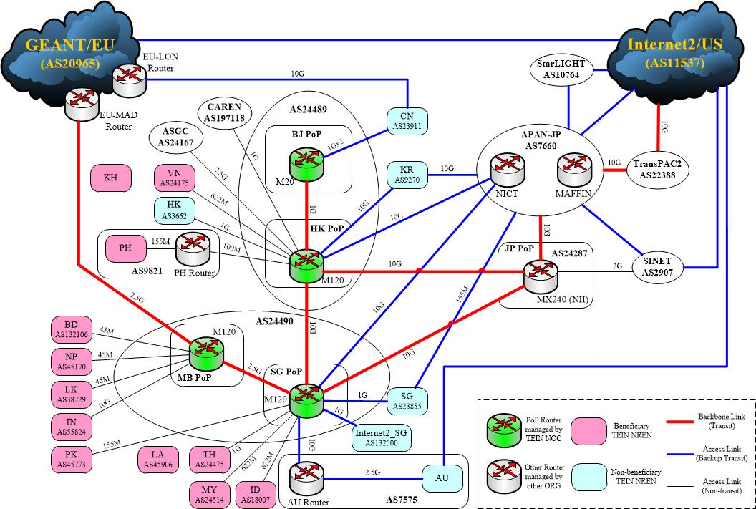
TEIN Topology
(~ 31 Jan 2015)

Slide 51
Summary of Routing Protocols
AS ‘B’
AS ‘C’
AS ‘A’
BGP
BGP
BGP
Intra-AS, eg. OSPF
Intra-AS, e.g. RIP
Intra-AS, eg. OSPF
Multi-homed AS
Transit AS
e.g. backbone service provider
Stub AS

